Slide 1
Statistics in data analysis
Useful terminology, IRL application and challenges

Slide 2
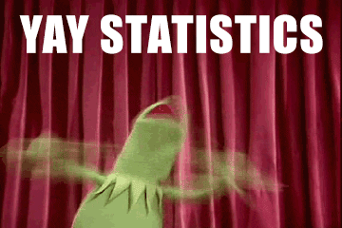

Slide 3
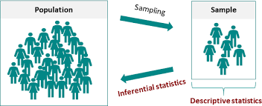
Glossary of terms
Descriptive statistics, EDA
Inferential statistics, hypothesis testing T test, AB test, ANOVA
Level of significance, p-value
Confidence level & interval
Central Limit Theorem

Slide 4
inferential statistic methods
The scientific method uses inferential statistics to determine if the independent variable has caused a significant change in the dependent variable and if that change can be generalized to the larger population
To do so we must have a representative data sample
We can propose an insight or prediction based on the sample data
We can also conduct a hypothesis test(/statistical test) to find evidence that sample evidence can be used to support some inference

Slide 5
Inference | Article | Population | Sample | Is the method of statistical inference sound? Is the sampling method representative?
Hegemony of english language is in decline | spotify language use - the economist | Global music streamers | 320k records, 100 popular hits, most streamed song / week, 70 countries, 5 years
NY police are giving incorrect parking fines | Tumblr - open data- nyc parking tickets | NYC parking tickets awarded | 30 parking spots randomly selected where > 5 tickets
3 x variation in bowel cancer death rates between UK areas | Independent blog - inspired by BBC article | Full UK population | Rate per 100k, stats calculated and shared by ONS (UK government agency)
We touch our phones 2,617 times a day on average | Cnbc article summarising studies eg dscout | American smartphone users | 94 android users out of 100k (demographic s.) 5 days, 24 hours
¼ toilets in rural indian schools unusable | Business standard.com ASER survey | All rural schools in india | 17.4k schools, 589 districts

Slide 6
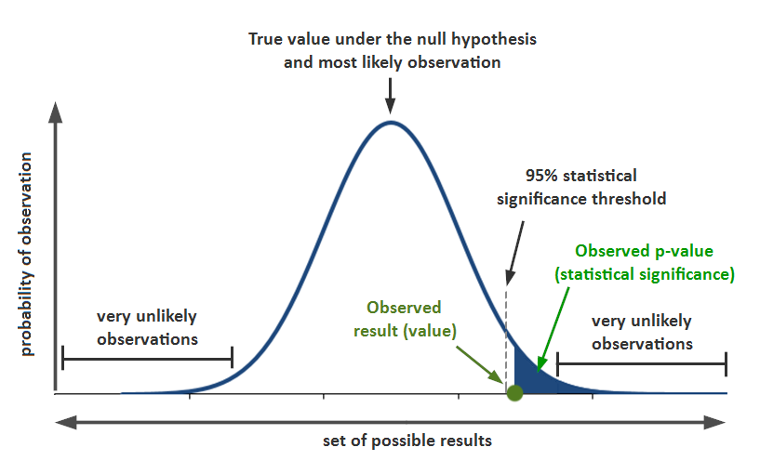
P value

Slide 7
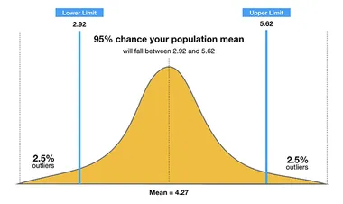
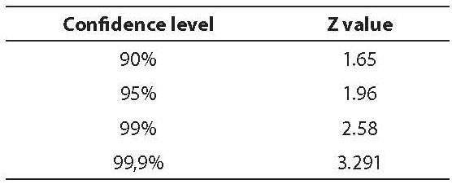
confidence interval

Slide 8
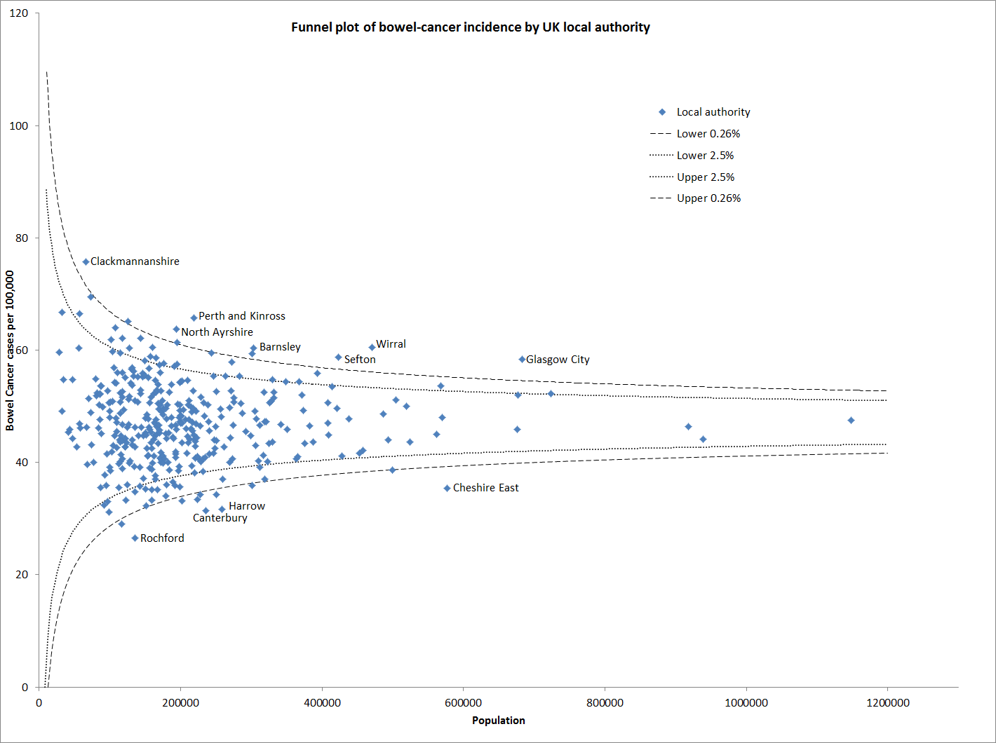
central limit theorem

Slide 9
Inference | Hypothesis test type | Reference mean | Sample | Test fail or succeed
Boys in this school are underweight | T Test | External benchmark +critical value(from t) | 25 boys in one school
This campaign design creates more leads than the other | AB testing | Internal comparison + significance level (from z) | 2 campaigns run at the same time, with same conditions, similar numbers of participants
Vending machine sales alter with different displays | ANOVA test | Internal comparison + significance level (from f) | At least 3 displays trialled in the same time frame, similar conditions

Slide 10
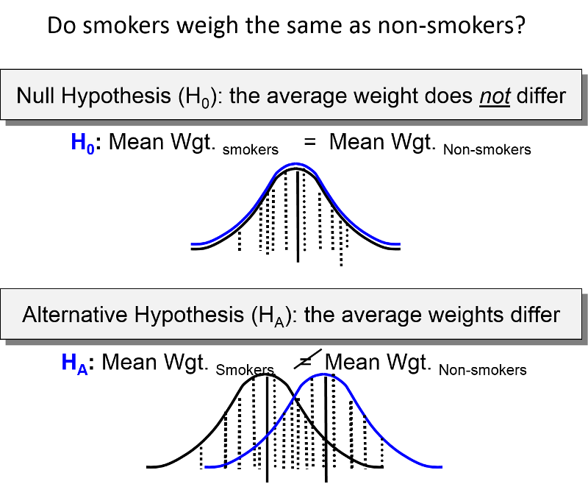
T test

Slide 11
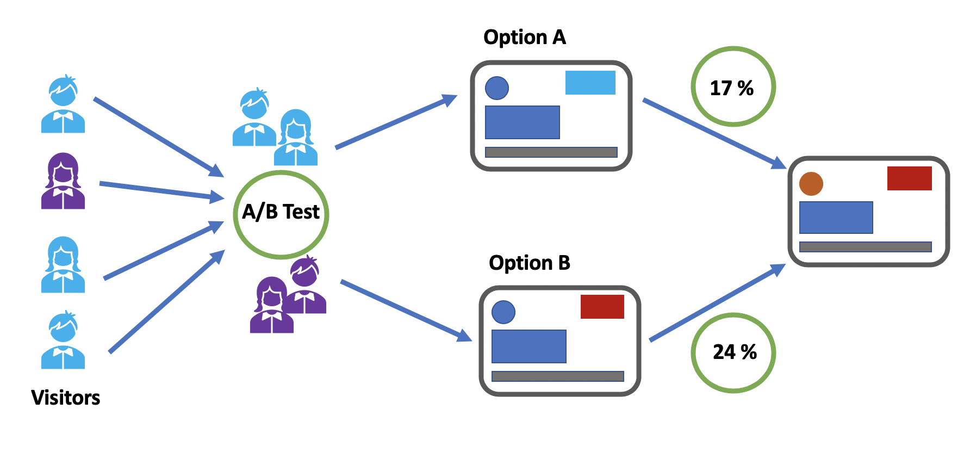
AB test

Slide 12


What is an AB test?
AB test
An A/B test is a randomized experiment, in which the "A" and "B" refer to 2 variants, undertaken in order to determine which variant is the more "effective.". This is popular in web analytics and mobile application development

Slide 13
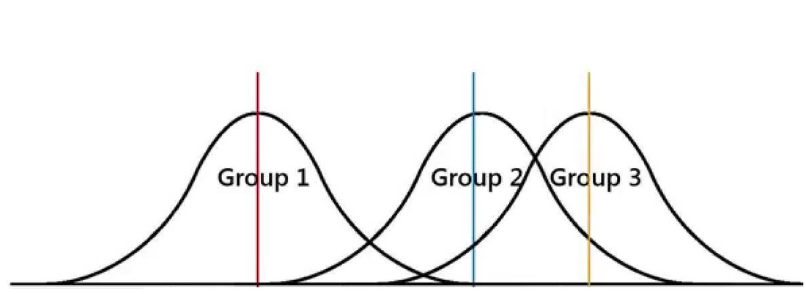
ANOVA test
A technique to compare if there is a substantial difference between the means of three or more samples
Samples may have been treated differently

Slide 14




Slide 15
